Slide 1
Tools For Quality Assessment
Sultan Qaboos University
College of Education
ILT Department
2013

Slide 2
Outline
1
Process flow chart
2
Graphs
3
Pareto analysis
5
Scatter diagram
6
Check sheets
7
Control charts
8
Brainstorming
4
Fish-bone diagram

Slide 3
1. Process flow chart
A flow chart is symbolic representation of stages in a process.
It records the series of activates and events in a process in such away that communication becomes instant and clear.
It useful when a problem needs systematic approach.
It help to identify critical steps and also ensuring that all steps are carried without fail making it error free ensuring quality.

Slide 4
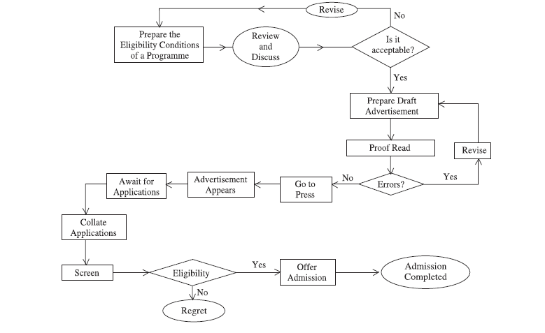

Slide 5
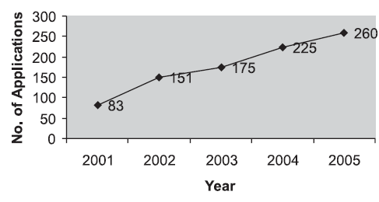
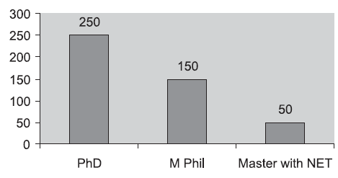
2. Graphs
Tools to present information in a concise and graphical manner.
There are different types of graphs to represent data:
- Line diagram
- Histograms
- Pie charts

Slide 6
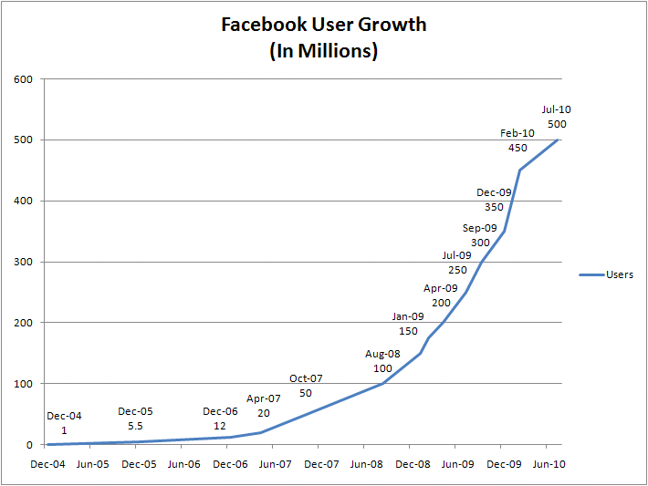
Ex. Line Graph

Slide 7
3. Pareto Analysis
A tool used to prioritize problems for solutions
It used pareto principle (known as the “80-20 Rule”). The idea behind that is, by focusing on the 20%, we can improve 80% of results.

Slide 8
Example
Jack has taken over a failing service center, with a host of problems that need resolving. His objective is to increase overall customer satisfaction.
He decides to score each problem by the number of complaints that the center has received for each one.

Slide 9
# | Problem (Step 1) | Cause (Step 2) | Score (Step 3)
1 | Phones aren't answered quickly enough. | Too few service center staff. | 15
2 | Staff seem distracted and under pressure. | Too few service center staff. | 6
3 | Engineers don't appear to be well organized. They need second visits to bring extra parts. | Poor organization and preparation. | 4
4 | Engineers don't know what time they'll arrive. This means that customers may have to be in all day for an engineer to visit. | Poor organization and preparation. | 2
5 | Service center staff don't always seem to know what they're doing. | Lack of training. | 30
6 | When engineers visit, the customer finds that the problem could have been solved over the phone. | Lack of training. | 21

Slide 10
Lack of training (items 5 and 6) – 51 complaints.
Too few service center staff (items 1 and 2) – 21 complaints.
Poor organization and preparation (items 3 and 4) – 6 complaints.

Slide 11
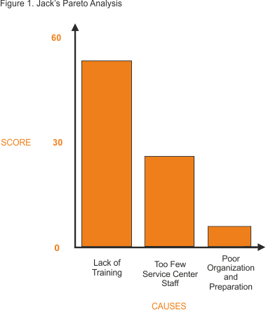

Slide 12
4. Fish-bone diagram
It is a tool for analysis and open thinking in problem solving.
Useful in organizing ideas during and after a brainstorming session .

Slide 13
Performance Assessment
Fishbone Diagram
Causes
Skills and Knowledge
Environment
Motivation
Incentives

Slide 14
Performance Assessment
Fishbone Diagram
Causes
Skills and Knowledge
Environment
Don’t understand
changing work environment
Very chaotic
Too loud
Resisting change
High Employee
Turnover
New Procedures are
not well defined
Current incentive system
is not working
Lack of available training classes
Motivation
Incentives

Slide 15
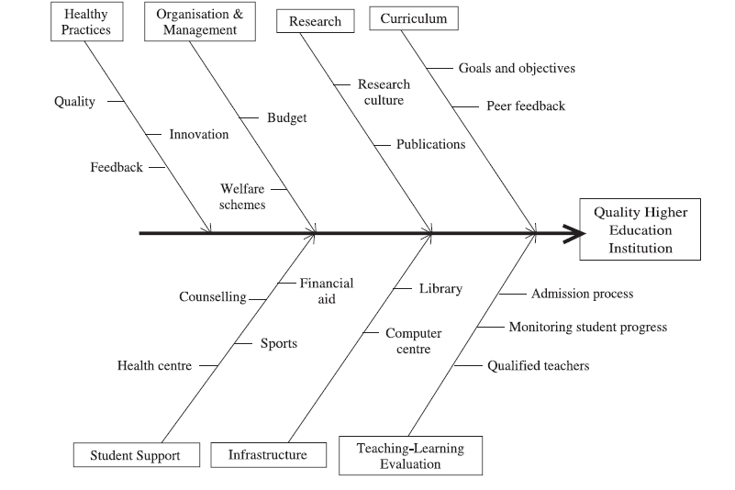
Quality in education

Slide 16
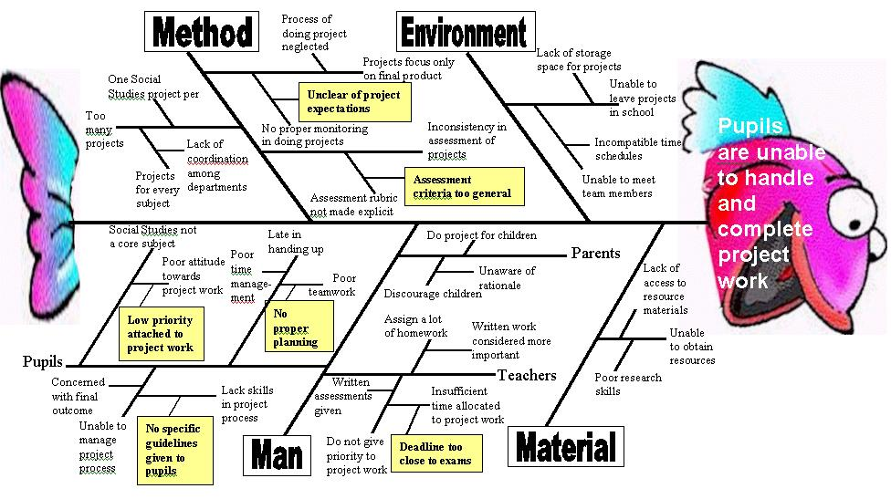

Slide 17
5. Scatter Diagram
The scatter diagram is a method to determine the relationship between the cause and effect in a pictorial manner.
Scatter diagram show pattern of association or otherwise of two variables/parameters.

Slide 18
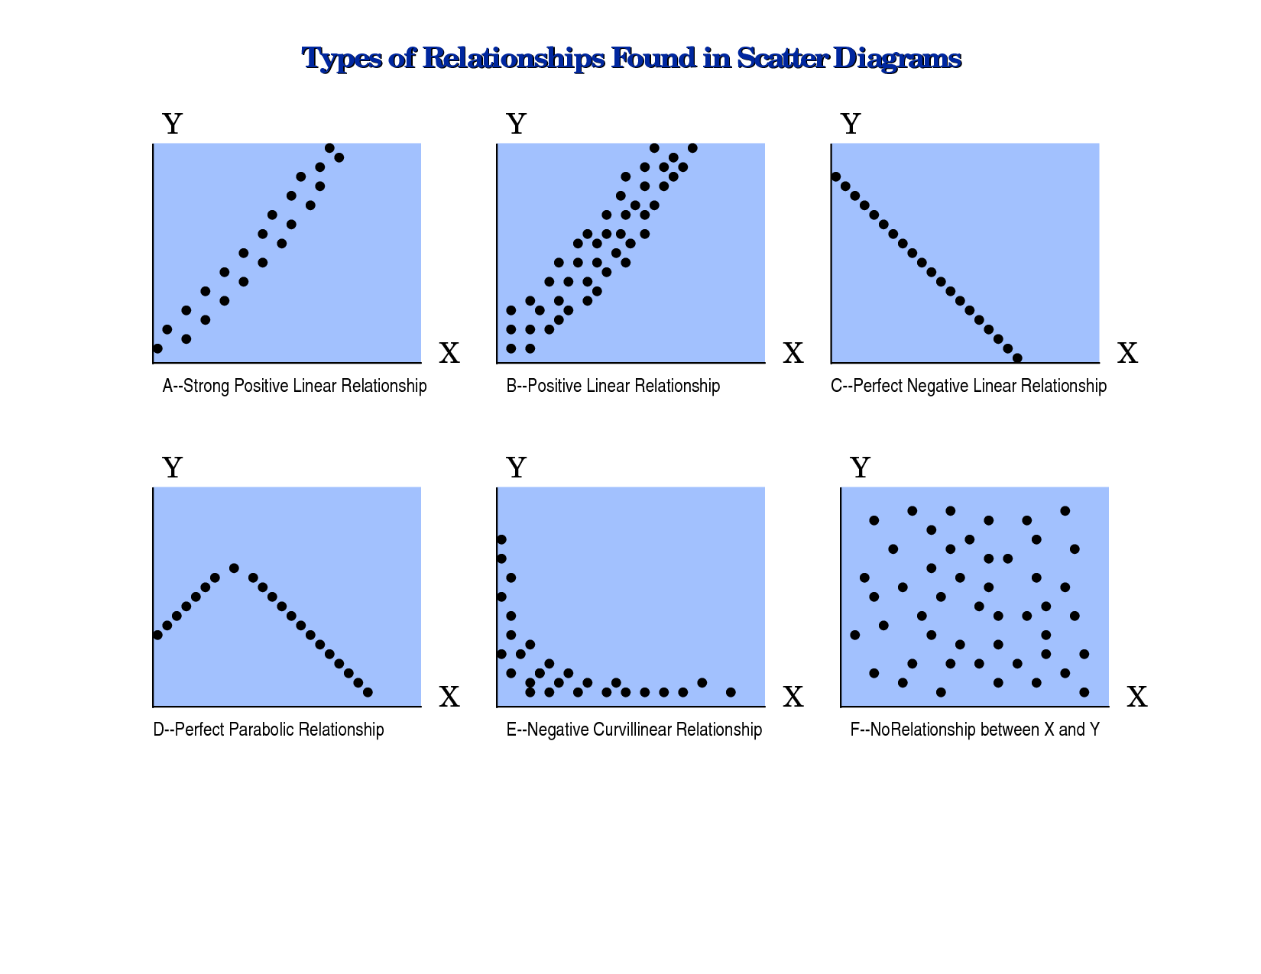
Scatter Diagram

Slide 19
6. Brainstorming
It is one of the most fundamental processes of generating ideas and solutions for problem solving.
It can be used for all the tools discussed above to generate ideas for assuring quality.
Rules may be followed during the brainstorming session:
Be clear about the topic of brainstorming
List all ideas a they are expressed
Wild ideas are welcome
Do not criticize people’s ideas
Build on ideas

