Slide 1
SQU
College of Education
Instructional & Learning Technologies Department
TECH4211
history and importance
of quality assurance
Dr. Abdelrahman Mohamed
Ahmed
Spring2014

Slide 2
Outline
History of quality assurance.
Leading thinkers on quality.

Slide 3
History of Quality Assurance
Quality as a concept is a 20th century phenomenon.
Its root in the industry and management.
The Age of craftsmanship (pre-1900)
During the middle age in Europe , quality assurance was informal.
The responsibility of quality remained with the worker.
Groups of craftsman joined together and set standards for their field.

Slide 4
History of Quality Assurance
Quality control by foreman (1900-1920)
around 1750 factories began to replace private craftsmen as the central means of production.
this stage necessitated the need for inspection of the products (to ensure they met specifications before they left the factory).
factories were overseen by foreman who controlled quality.
Inspection based- quality control (1920-1940)
lead to the first formal quality control system.

Slide 5
History of Quality Assurance
Statistical approach (1940-1960)
Statistical approach ruled the domain of the quality movement in Japan and America.
Wlater A. (1930) introduced the systematic process for quality. Statistical process control (SPC). “to study variation in the performance of systems”
Rather than looking at just the end product, Wlater broke down the production into several mini-process, each of which were to be evaluated.

Slide 6
History of Quality Assurance
After 1960 – 1980 quality assurance began to involve total quality control.
In 1980 Total Quality management “ TQM” occurred.
1990- Present “TQM” the culture of continuous improvement.
aims for continues improvements.
Involve suppliers and costumers.
concerns products and processes.
responsibilities with all workers.
delivered through team work.

Slide 7
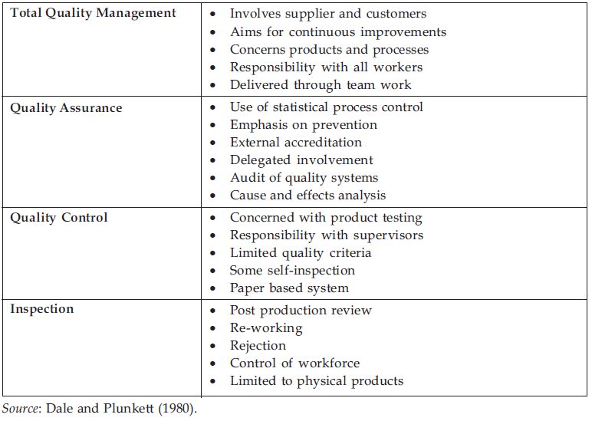
Hierarchy of quality management

Slide 8
LEADING Thinkers ON QUALITY
The most three important contributors of the quality movement are:
W. Edwards Deming
Joseph Moses Juran
Philip B. Crosby

Slide 9
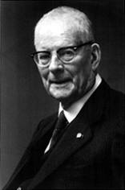
W. Edwards Deming
Deming is regarded as father of quality movement.
he stressed شدد that the responsibility for quality remains with top management.
he emphasized on الوقايةprevention rather than العلاجcure as the key to quality.

Slide 10
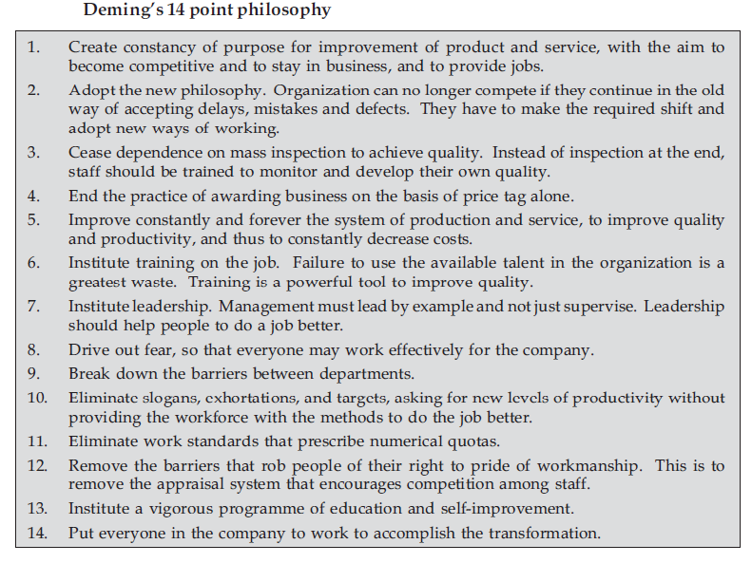

Slide 11
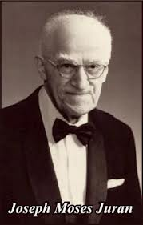
Joseph Moses Juran
he defined quality as “fitness for purpose” Products or service should meet its customer need not be fit for its purpose.
he identified three steps to quality improvement:
Make annual improvement plans.
Train everyone in the organization.
Leadership focuses on quality.

Slide 12
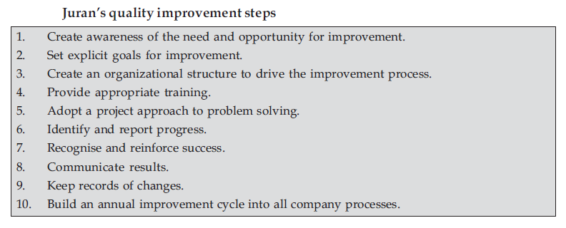
Juran ten steps approach to quality improvement

Slide 13
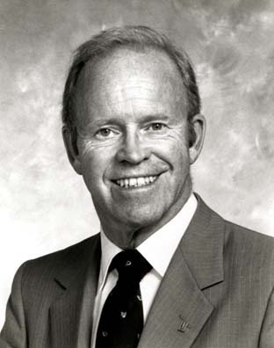
Phillip B. Crosby
He is the most influential management thinker in United States and Europe in quality.
He focuses in senior management and he has given two popular statement;
“ Zero Defect”
“ Quality is free”

Slide 14
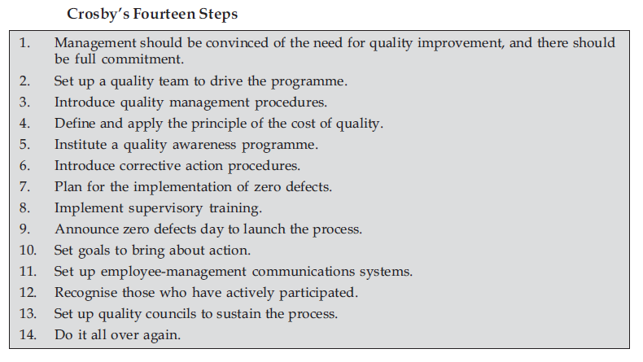

Slide 15
Summary
Quality as concept has its origins in the management and industry sector.
firstly, the responsibility of quality reminded with individual workers.
With the emergence of mechanization, came the issues of inspection, control and assurance of quality.
Deming, Juran and Crosby are the most important contributors in the field of the quality.

Slide 16
Reflective exercise
From all the views of Deming, Juran and Crosby in the context of the quality, what is important when considering them in the context of education?
(as a group write one page for that exercise)
See the implications for higher education.

